Slide 1




How well is Instagram archived?
A quantitative case study using Katy Perry’s Instagram account
Presented By:
Himarsha R Jayanetti
PhD Student
Department of Computer Science
Old Dominion University, Norfolk, Virginia
@HimarshaJ @WebSciDL
Created as a course requirement for CS895 Web Archiving Forensics (by Dr. Michael Nelson), Fall 2020

Slide 2
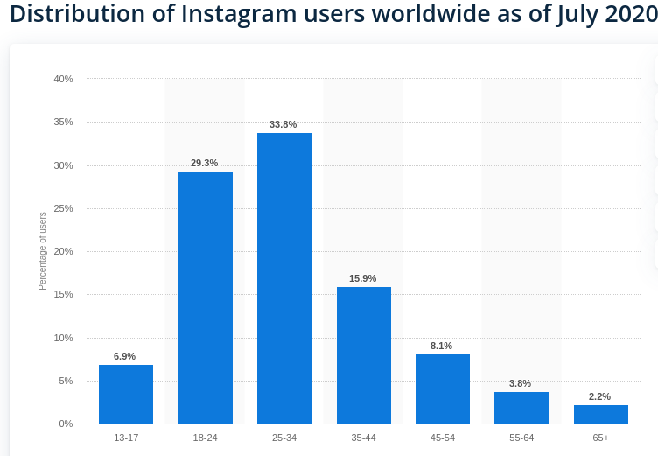
Instagram
Instagram is a photo and video sharing app created in the year 2010.
It is the 6th most popular social network worldwide with over 1 billion active users. https://www.statista.com/statistics/272014/global-social-networks-ranked-by-number-of-users/
About six in 10 Instagram users log in at least once daily. It’s the second most logged in social media site for daily use after Facebook. https://sproutsocial.com/insights/instagram-stats/
Most liked picture on Instagram: https://www.instagram.com/p/BsOGulcndj-/
https://www.statista.com/statistics/325587/instagram-global-age-group/#:~:text=With%20over%201%20billion%20monthly,91%20million%20Instagram%20users%20each
Notes:
Most liked photo on Instagram is a photo of an egg with 54.2 million likes.

Slide 3
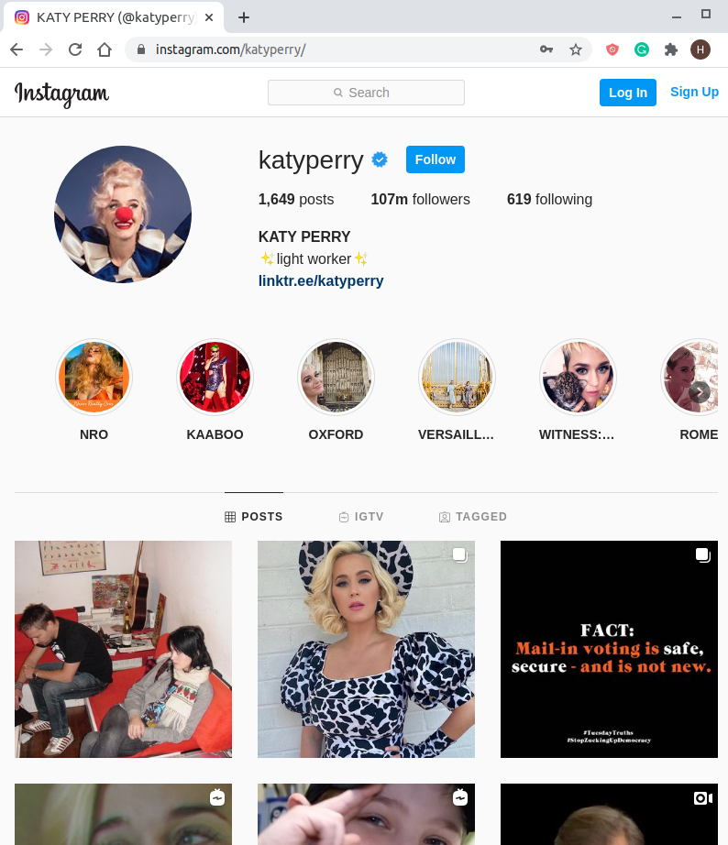
Katy Perry as a proxy for all of Instagram
She is the 20th most popular account in instagram with over 100 million followers. https://www.brandwatch.com/blog/top-most-instagram-followers/
She has ~1600 posts in her Instagram feed which is a moderate number of posts to be individually investigated.

Slide 4
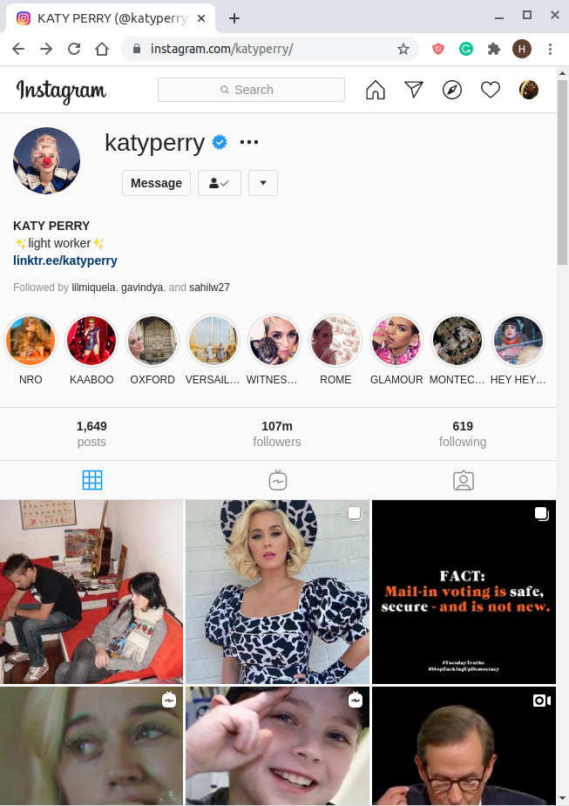
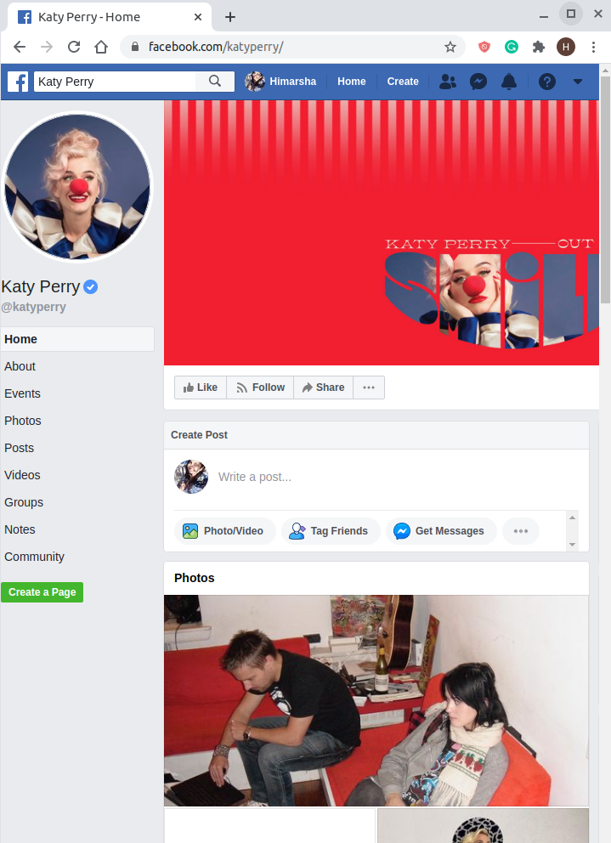
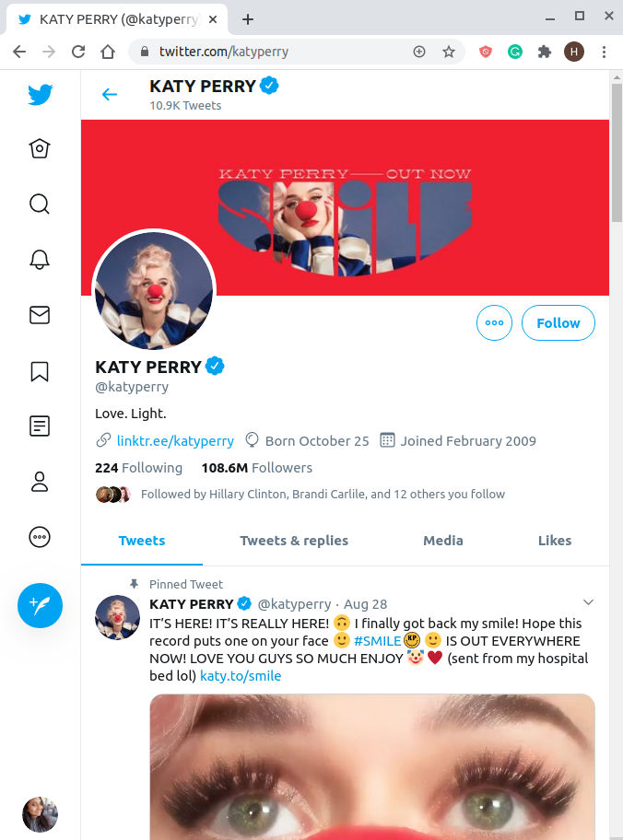
Katy post the same info across all platforms
Instagram, Facebook, and Twitter
https://www.facebook.com/katyperry/
https://www.instagram.com/katyperry/
https://twitter.com/katyperry
Twitter
Instagram
Facebook

Slide 5
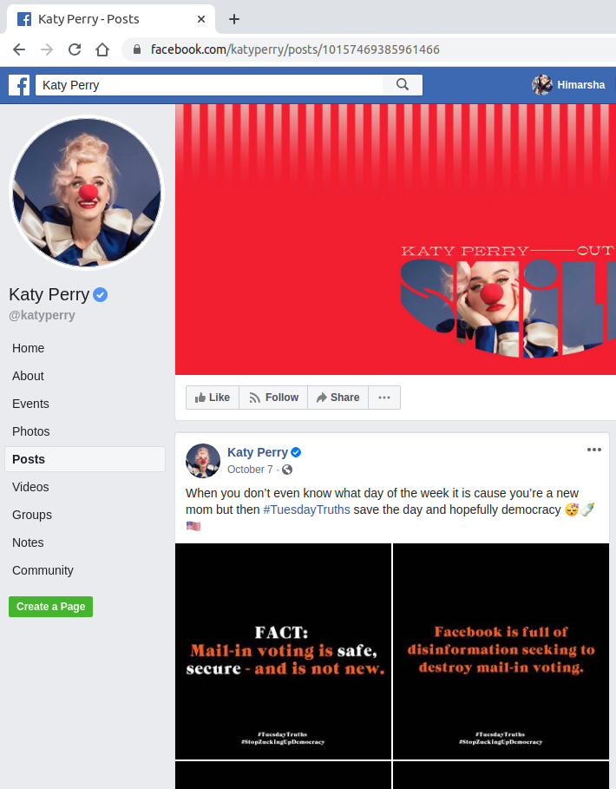
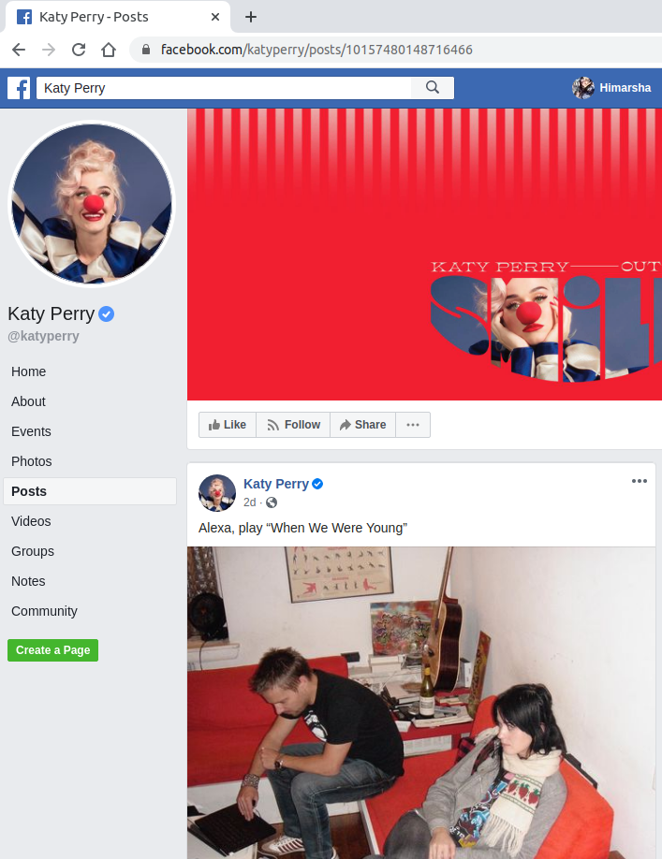
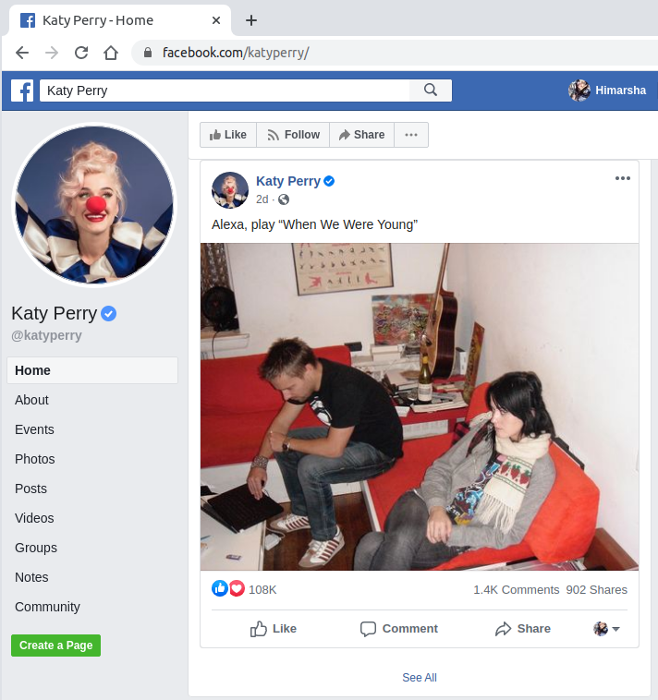
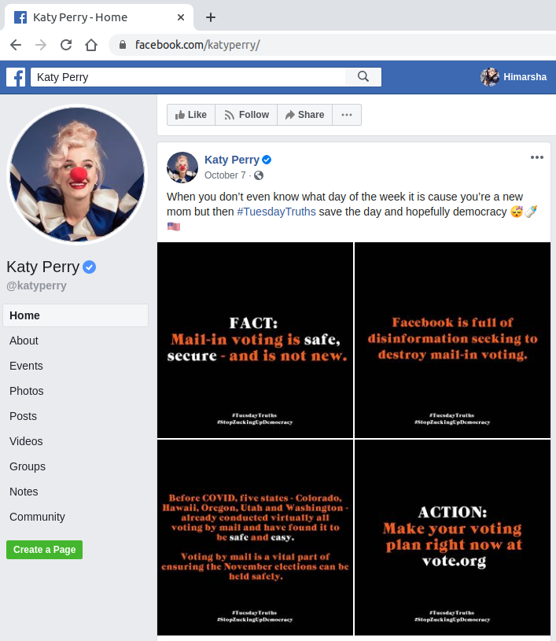
facebook.com/katyperry/posts/{17DigitNumericID}
https://www.facebook.com/katyperry/posts/10157469385961466
https://www.facebook.com/katyperry/posts/10157480148716466
https://www.facebook.com/katyperry/
Notes:
https://www.facebook.com/katyperry/posts/10157469385961466

Slide 6
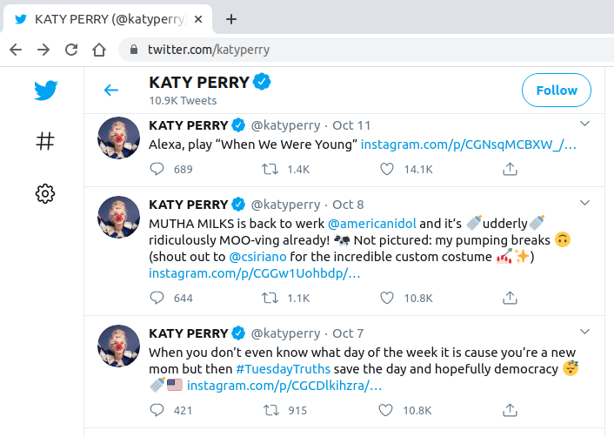
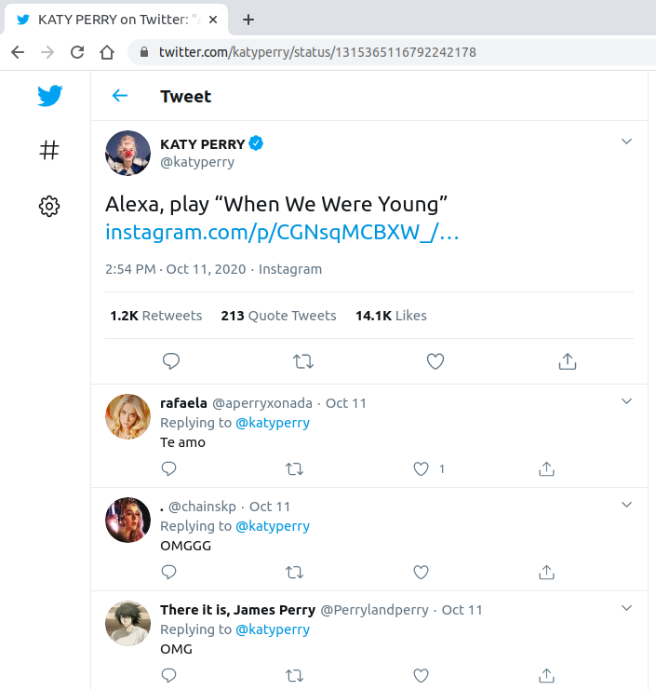
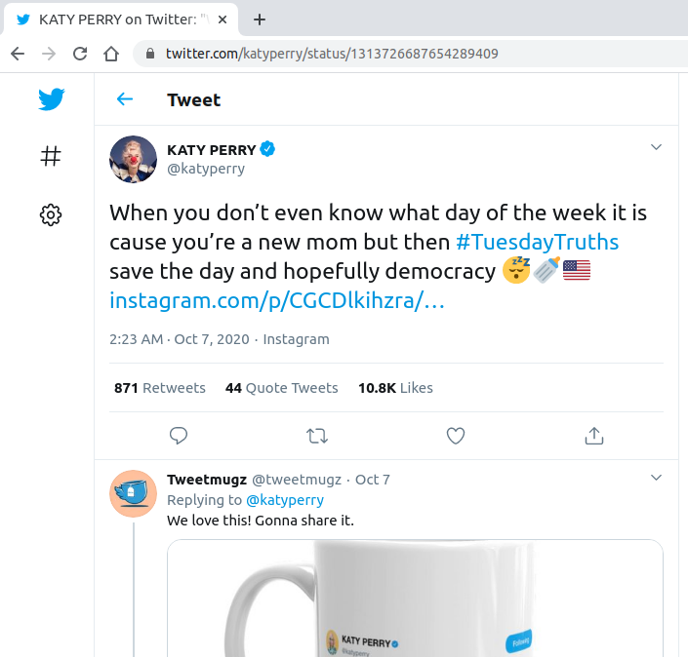
twitter.com/katyperry/status/{19DigitNumericID}
https://twitter.com/katyperry
https://twitter.com/katyperry/status/1315365116792242178
https://twitter.com/katyperry/status/1313726687654289409

Slide 7
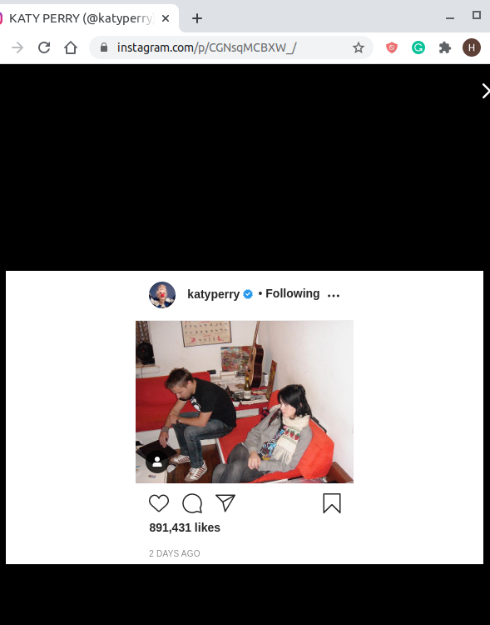
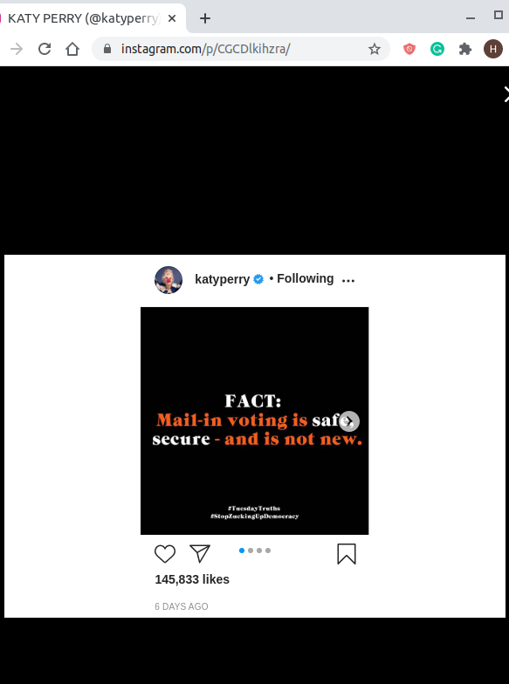
instagram.com/p/{11DigitID}
The post URLs are completely opaque.
https://www.instagram.com/katyperry/
https://www.instagram.com/p/CGNsqMCBXW_/
https://www.instagram.com/p/CGCDlkihzra/

Slide 8
How many mementos are available for
her account page in Internet Archive?
 | Number of Mementos
facebook.com/katyperry | 6552
twitter.com/katyperry | 120522
This data was collected through the Internet Archive’s CDX search on 2020-10-11.
http://web.archive.org/cdx/search/cdx?url=https://www.facebook.com/katyperry/&matchType=prefix
http://web.archive.org/cdx/search/cdx?url=https://twitter.com/katyperry/&matchType=prefix

Slide 9
Account Page:
How many captures are there across different web archives?
Below data shows how many mementos are available for her account page for all three leading social media platforms across different web archives. This data is collected through MemGator on 2020-10-11.
 | Internet Archive | Archive- It | archive.today | Library of Congress | UK Web Archive | Australian Web Archive | Portuguese Web Archive | Total
Instagram | 1803 | 108 | 7 | 4 | - | - | 2 | 1924
Facebook | 2032 | 1234 | - | 1 | 16 | 37 | - | 3320
Twitter | 4025 | 1185 | 2 | - | 58 | 2 | 1 | 5273

Slide 10
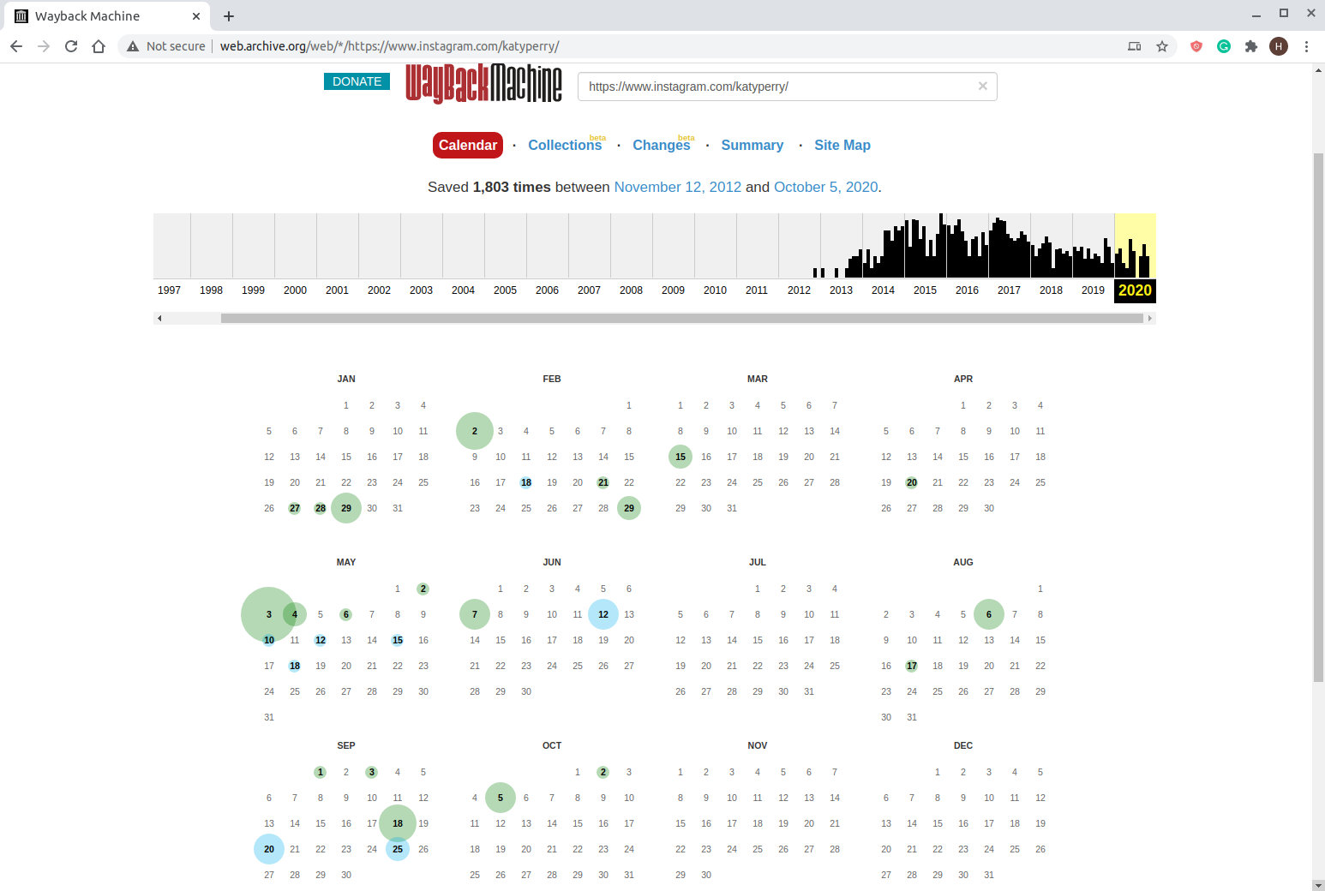
http://web.archive.org/web/*/https://www.instagram.com/katyperry/

Slide 11
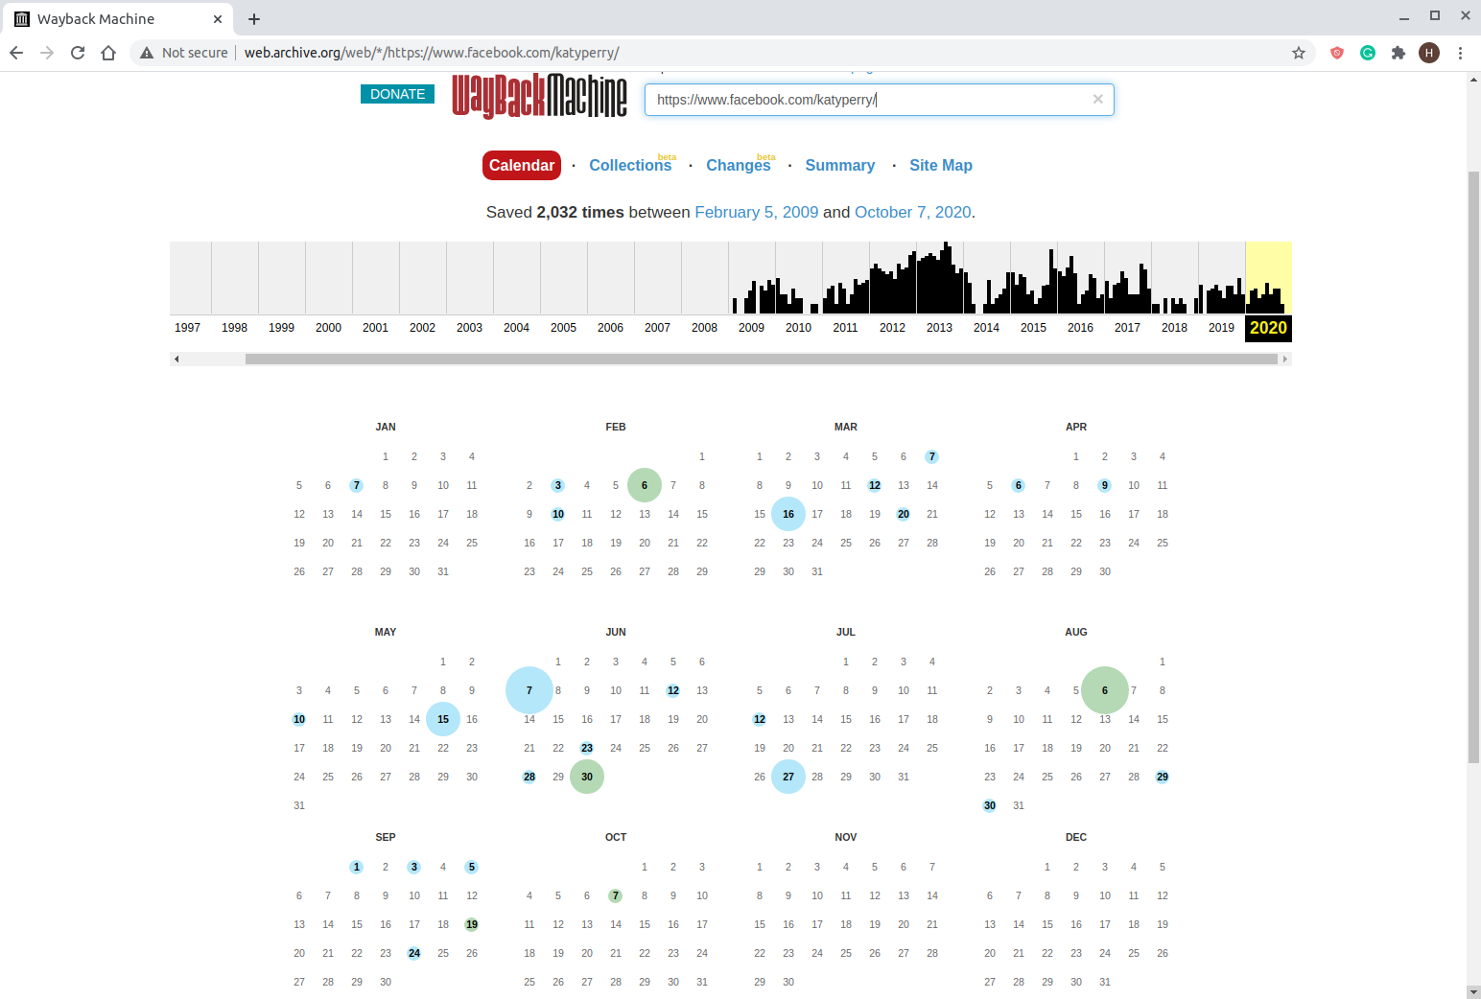
http://web.archive.org/web/*/https://www.facebook.com/katyperry/

Slide 12
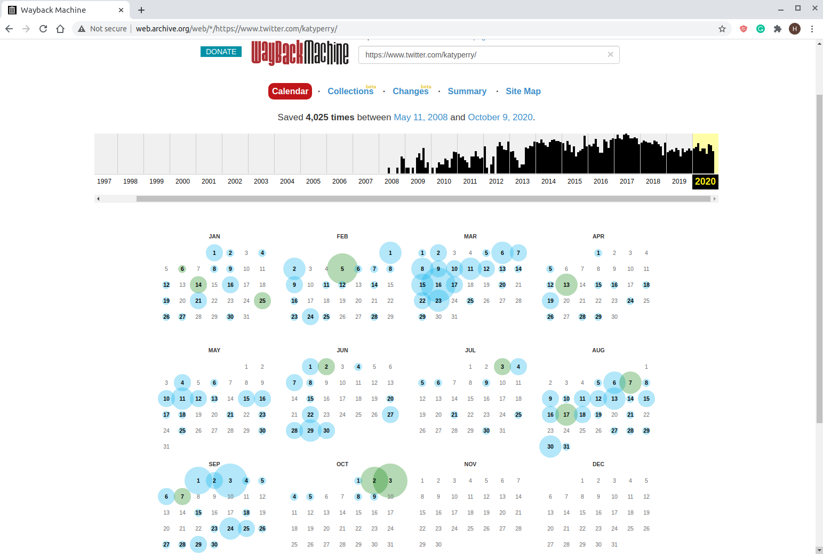
http://web.archive.org/web/*/https://www.twitter.com/katyperry/

Slide 13
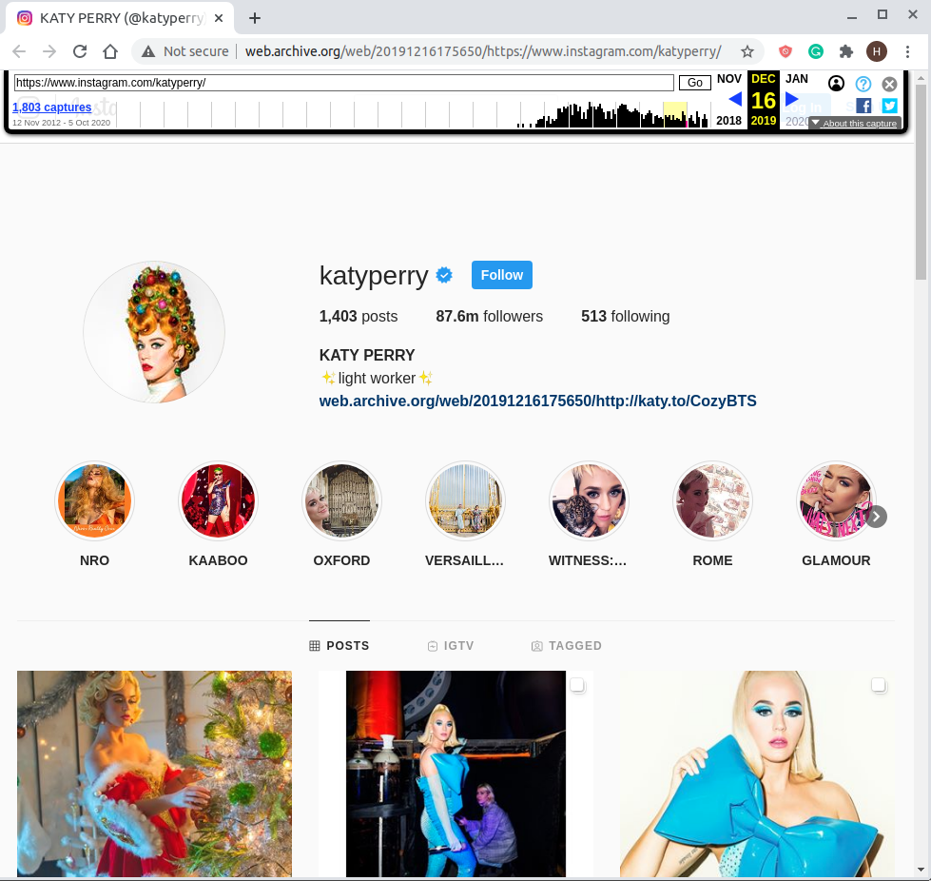
A memento of Katy’s account page
http://web.archive.org/web/20191216175650/https://www.instagram.com/katyperry/

Slide 14
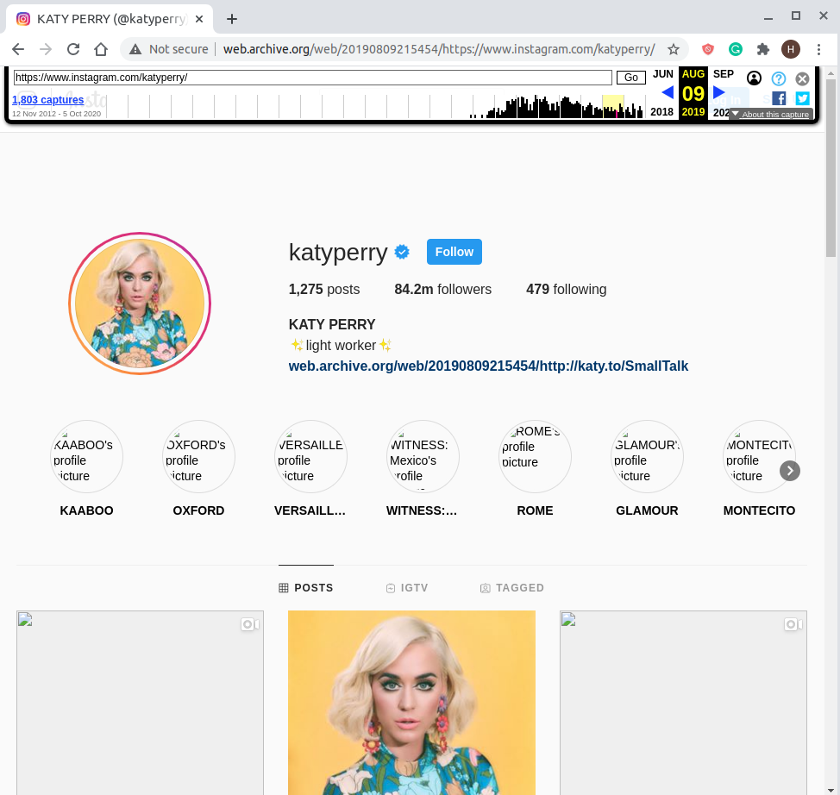
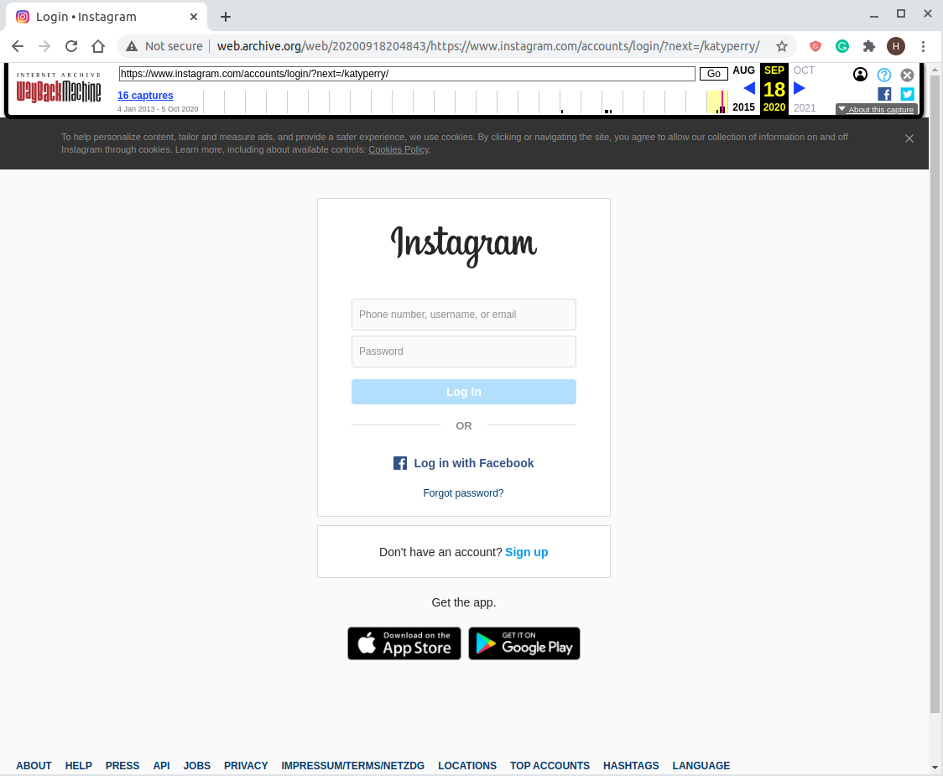
Not all mementos replay well!
http://web.archive.org/web/20190809215454/https://www.instagram.com/katyperry/
http://web.archive.org/web/20200918204837/https://www.instagram.com/katyperry/
Notes:
Simply having a memento doens't mean that it replays well.Quantifying how many good and bad is out of scope for this study, but it has to be acknowledged. We can also say that Twitter is far more likely to have a usable replay than the others.

Slide 15
Account Page: How often is her account archived?
This data is collected through MemGator on 2020-10-13, which shows how often her account page is archived for all three leading social media platforms.
 | First Memento | Last Memento | Total Days | Total Mementos | Days with Memento Count > = 1 | Percentage
Instagram | Mon, 12 Nov 2012 08:59:33 | Mon, 05 Oct 2020 20:10:55 | 2885 | 1924 | 802 | 27.8%
Facebook | Thu, 05 Feb 2009 11:38:42 | Wed, 07 Oct 2020 06:02:10 | 4263 | 3320 | 872 | 20.46%
Twitter | Sun, 11 May 2008 11:06:18 | Fri, 09 Oct 2020 10:33:54 | 4535 | 5273 | 1863 | 41.08%

Slide 16
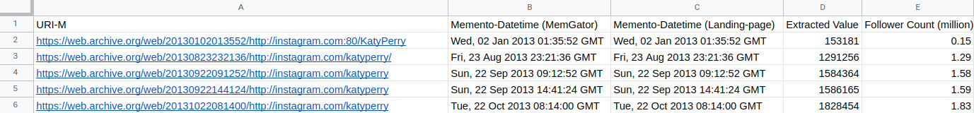
Katy Perry’s IG: Follower Count via Web Archives
Collected all the URI-Ms and datetime for “https://www.instagram.com/katyperry/” using MemGator.
Made a request to each of those URI-Ms and obtained:
Memento Datetime: from the “memento-datetime” header value in the response.
(Used the python requests library which by default follows all the redirects )
Follower Count: from the HTML resource obtained from the response body received.
https://docs.google.com/spreadsheets/d/1KoO5FOtZLqGjZsGKxaNYpkZVrk3kydMu0nNM2IUmKww/edit?usp=sharing

Slide 17
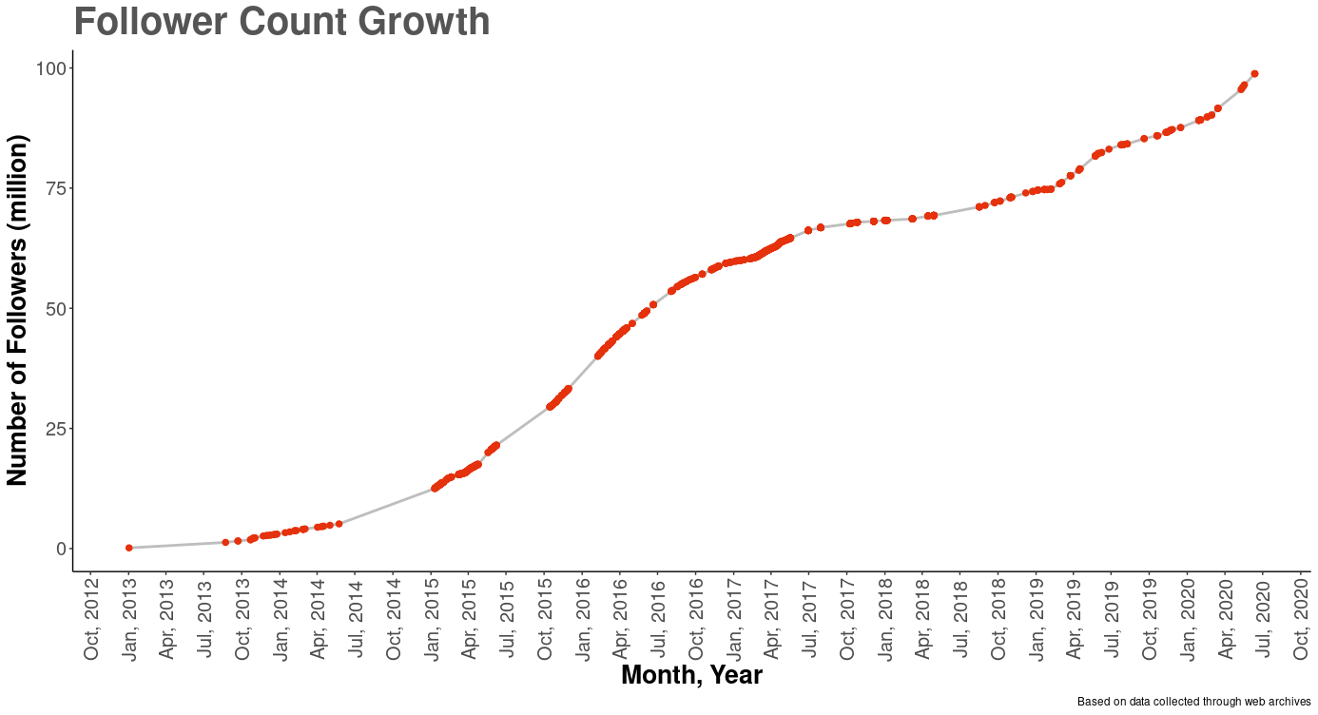
Follower count using historical data from web archives

Slide 18
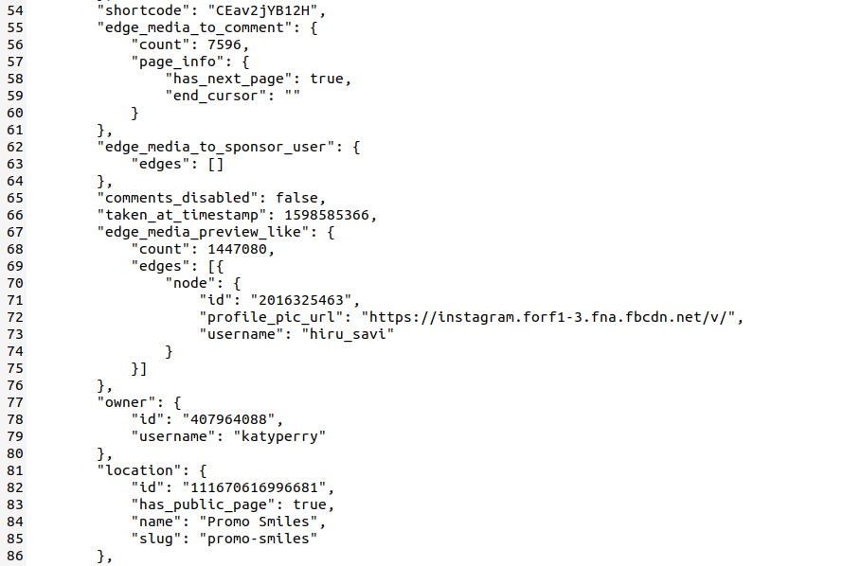
How the data was extracted for the individual posts
As september 24th 2020, she had a total of 1642 posts in her account IG feed.
Added two additional fields into the dataset:
Converted the published datetime from unix to UTC.
Used the short code to build the URL since the URL is of the format: "https://www.instagram.com/p/shortcode/"

Slide 19
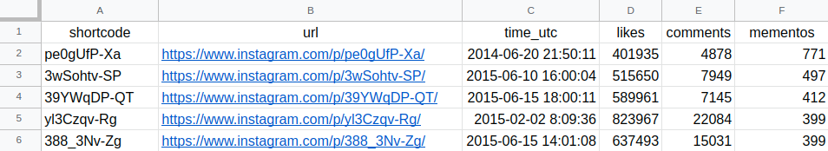
Dataset of 1642 individual posts including the memento count
The collected URLs were then run through MemGator which aggregates 16 different archives to collect the number of mementos for each URL.
https://docs.google.com/spreadsheets/d/1rrjlTwU5Jc-vpm5O_9QGFzBCkcXNRhuPVOZq5tb9lmA/edit?usp=sharing

Slide 20
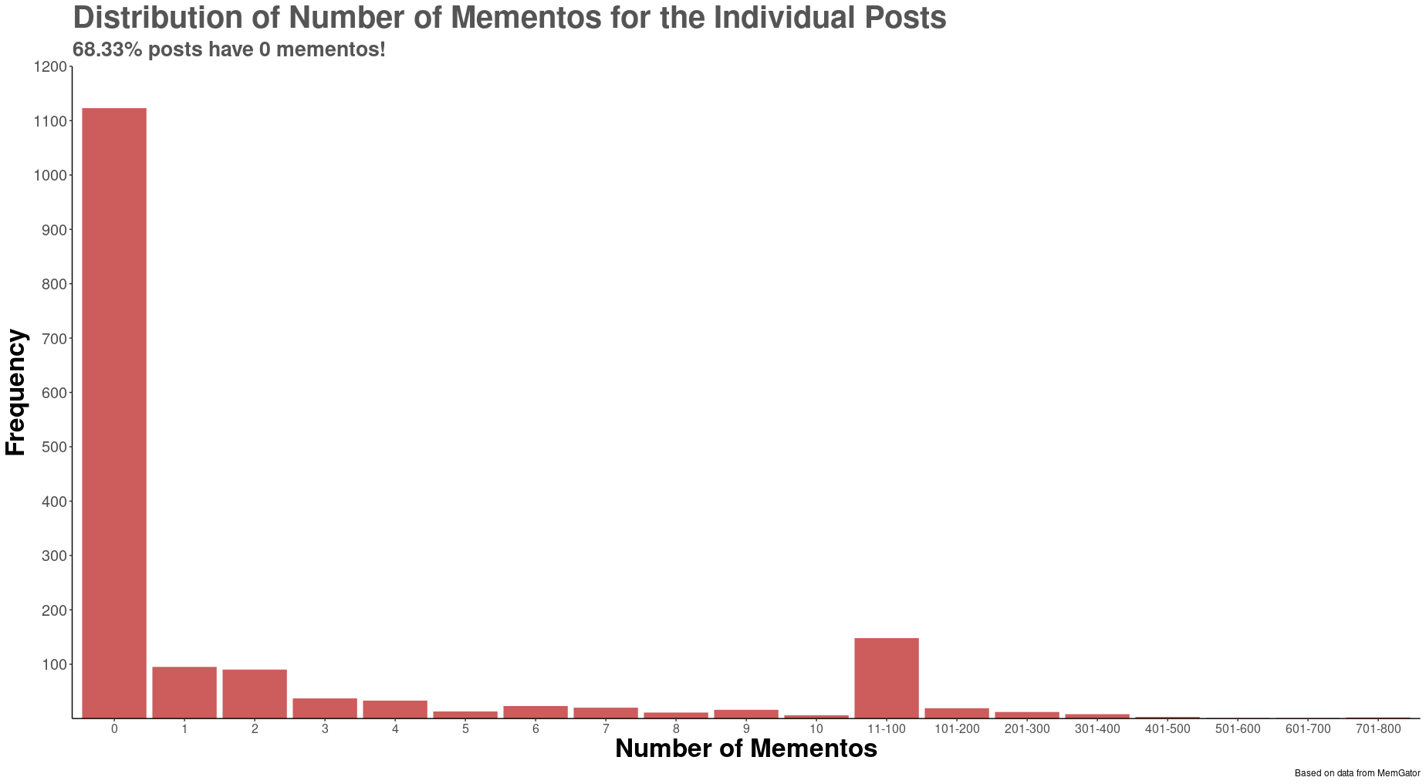
68% of IG posts have zero mementos

Slide 21

Correlation between likes, comments, and Mementos
The URLs were ranked and used to find the Kendall’s Tau-b Correlation Coefficient to check the correlation between:
Number of mementos Vs Likes
Number of mementos Vs Comments
Likes Vs Comments
Number of memento’s Vs Engagement: SUM(Likes, Comments)
https://drive.google.com/file/d/1s5LZ7GqTTzOmpqEyhSp4stSXdQpMGuOX/view?usp=sharing

Slide 22
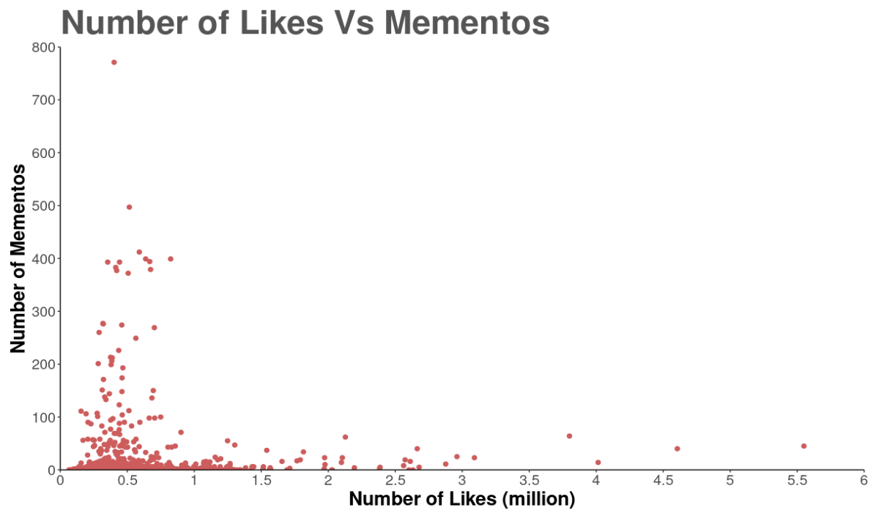
Weak Positive Correlation Between Mementos and Likes
Likes Vs Mementos:
Tau-b: 0.2171644
Notes:
* I have ranked the 1642 posts according to the and checked the correlation between those.

Slide 23
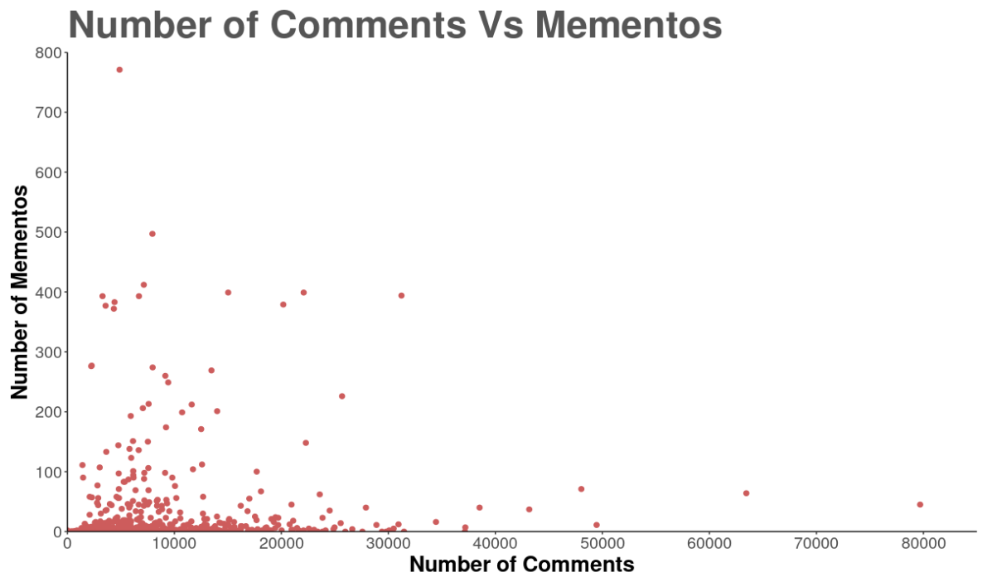
Weak Positive Correlation Between Mementos and Comments
Comments Vs Mementos:
Tau-b: 0.340613

Slide 24
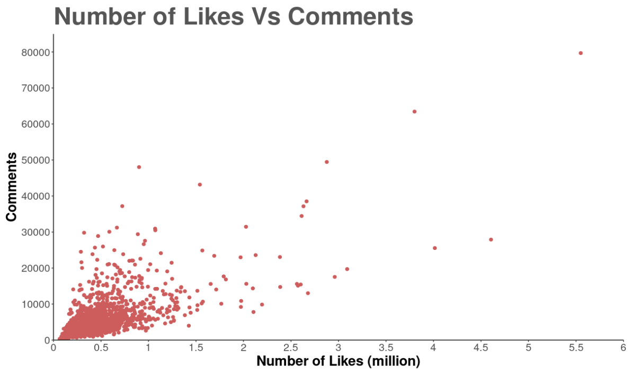
Moderately Positive Correlation Between Likes and Comments
Likes Vs Comments:
Tau-b: 0.551134

Slide 25
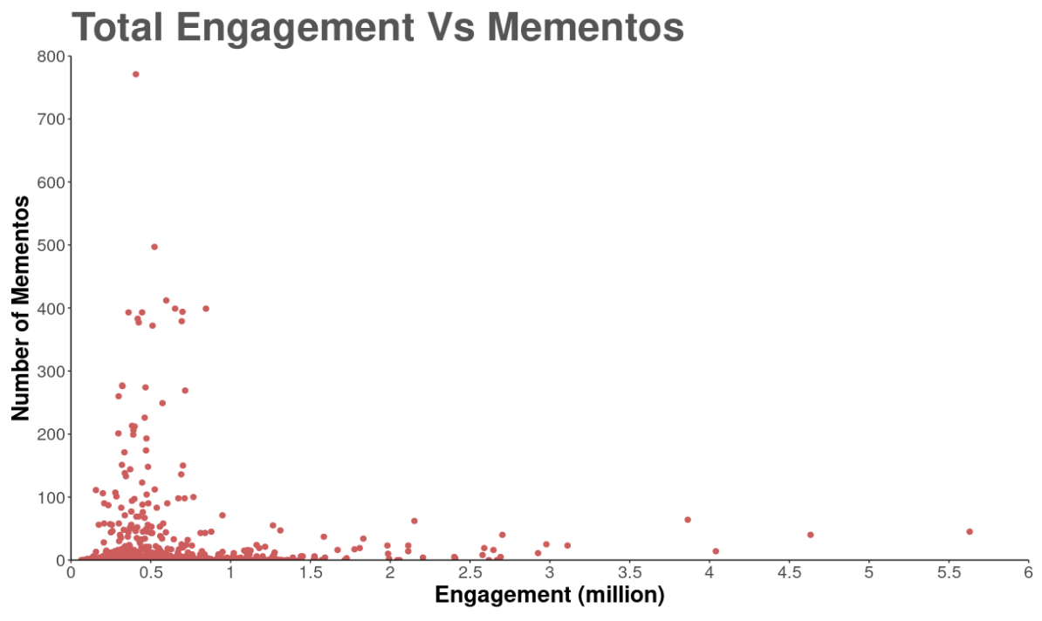
Weak Positive Correlation Between Mementos and Engagement: SUM(Likes, Comments)
Engagement Vs Mementos:
Tau-b: 0.2203515

Slide 26
Key Takeaways:
There's a weak positive correlation between engagement and archiving
General norm is that number of copies in web archives act as a proxy for checking how popular an URL is.
In this case, Katy Perry is the 20th most popular person on IG, still, only 1/3rd (1122 out of 1642) posts are archived.
Twitter is well-archived, Facebook is not well-archived as compared to Twitter, but they're both miles ahead of IG.

